Slide 1
IBM DATA SCIENCE CAPSTONE PROJECT
IJEZUE EBUKA

Slide 2
EXECUTIVE SUMMARY
The rapid advancement of commercial spaceflight has created new opportunities and competitive pressures. SpaceX currently dominates the market due to its cost-efficient rocket launches, largely made possible by the successful recovery and reuse of Stage 1 boosters.
This capstone project uses publicly available data from the SpaceX API and Wikipedia to build machine-learning models that predict the success of rocket landings. Data preprocessing included feature engineering, one-hot encoding of categorical data, and data standardization. Four models were trained and evaluated: Logistic Regression, Support Vector Machine, Decision Tree, and K-Nearest Neighbors. Each model achieved an average accuracy of approximately 83.33%, though they consistently overpredicted successful landings. While results are promising, further data collection is essential to improve model precision and real-world applicability.

Slide 3
INTRODUCTION
The commercial space age is underway, with SpaceX leading the charge through innovation and cost reduction. Its pricing advantage is the ability to recover and reuse the Stage 1 rocket booster.
Using collected data from the SpaceX public API and supplementary engineered a dataset labeled by landing success. We then performed exploratory data analysis using SQL queries, visualizations, and geospatial mapping tools like Folium.
After cleaning and transforming the data—including one-hot encoding categorical features and standardizing inputs—we implemented and fine-tuned four supervised learning models. Our goal was not only to achieve high accuracy but also to understand the factors influencing rocket recovery outcomes. The models performed similarly, each reaching 83.33% accuracy, with an observed tendency to overpredict success. This suggests that more balanced and granular data could help develop a more reliable predictive system in future iterations.

Slide 4
DATA COLLECTION AND WRANGLING
Data was collected from SpaceX and Wikipedia using web scraping techniques
Data Columns
SpaceX API:
FlightNumber, Date, BoosterVersion, PayloadMass, Orbit, LaunchSite, Outcome, Flights, GridFins, Reused, Legs, LandingPad, Block, ReusedCount, Serial, Longitude, Latitude
Wikipedia Table:
Flight No., Launch site, Payload, PayloadMass, Orbit, Customer, Launch outcome, Version Booster, Booster landing, Date, Time
Label Creation (for ML Training)
Success = 1, Failure = 0
Outcome = Mission Outcome + Landing Location
New column class:
1 → True ASDS, True RTLS, True Ocean
0 → None, False ASDS, False RTLS, False Ocean

Slide 5
EDA AND VISUAL ANALYTICS METHODOLOGY
EDA was conducted on key variables: Flight Number, Payload Mass, Launch Site, Orbit, Class, and Year.
Visualizations Used
Comparisons:
Flight Number vs. Payload Mass
Flight Number vs. Launch Site
Payload Mass vs. Launch Site
Orbit vs. Success Rate
Flight Number vs. Orbit
Payload vs. Orbit
Yearly Success Trend
Chart Types:
Scatter plots, line graphs, and bar charts were used to uncover potential relationships useful for machine learning model training.

Slide 6
EDA WITH SQL METHODOLOGY
Loaded the dataset into IBM DB2 using SQL-Python integration.
Executed SQL queries to explore and understand the dataset.
Retrieved insights on:
Launch site names
Mission outcomes
Payload sizes by customer
Booster versions
Landing outcomes

Slide 7
EDA visual analytics METHODOLOGY (dash & Folium)
Folium Maps
Display launch sites and landing outcomes (success/failure)
Include proximity overlays to key locations: Railway, Highway, Coast, and City
Help explain the strategic placement of launch sites and visualize success by location
Dashboard Features with Dash
Pie Chart
Shows the overall distribution of successful landings
Can filter by individual launch site for detailed success rates
Scatter Plot
Inputs: Launch Site (All or Individual), Payload Mass (0–10,000 kg slider)
Highlights the relationship between success rate, payload mass, and booster version

Slide 8
PREDICTIVE ANALYSIS METHODOLOGY
Below are the prcesses taken for predictive analysis
Data Preparation: Split label column ‘Class’ from the dataset
Feature Scaling: Fit and Transform Features using StandardScaler
Data Splitting: Train_test_split data
Model Tuning
Use GridSearchCV on LogReg, SVM, Decision Tree, and KNN models
GridSearchCV (cv=10) to find optimal parameters
Model Evaluation
Score models on split test set
Confusion Matrix for all models
Barplot to compare scores of models

Slide 9
EDA WITH VISUALIZATION RESULTS

Slide 10
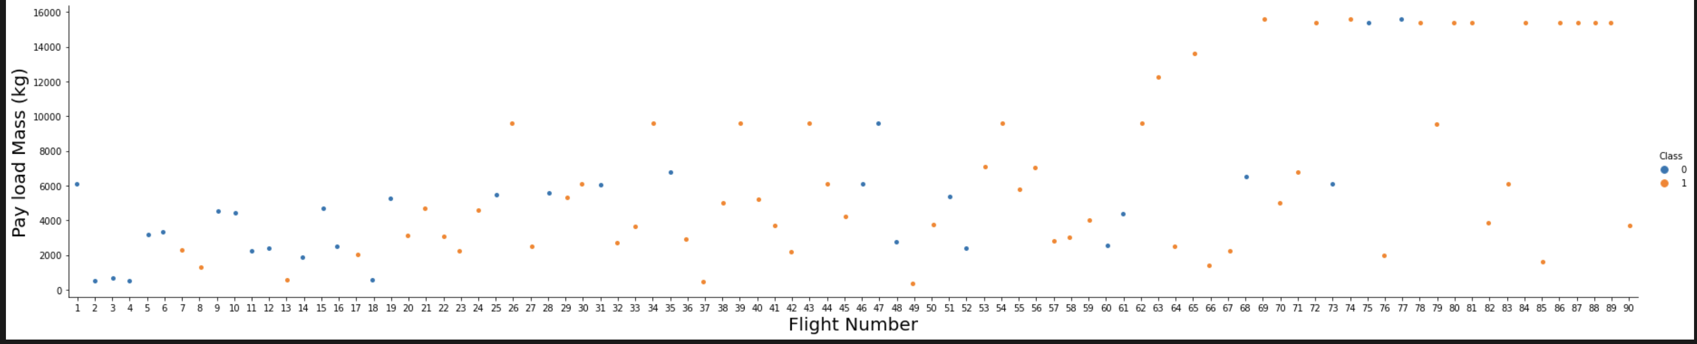
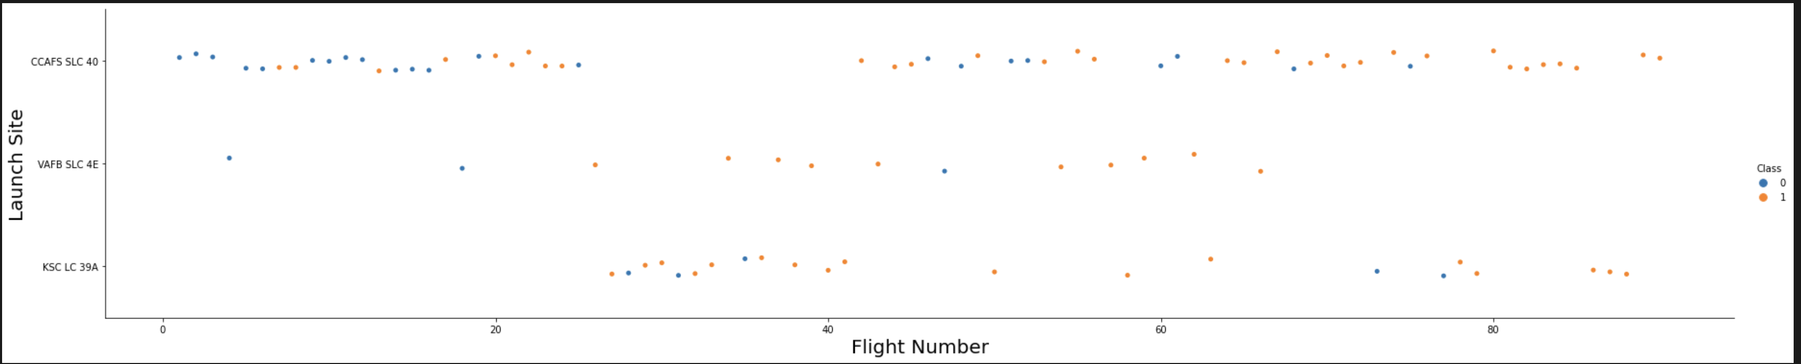
(FLIGHT NUMBER VS PAYLOAD) & (FLIGHT NUMBER VS LAUNCH SITE)

Slide 11
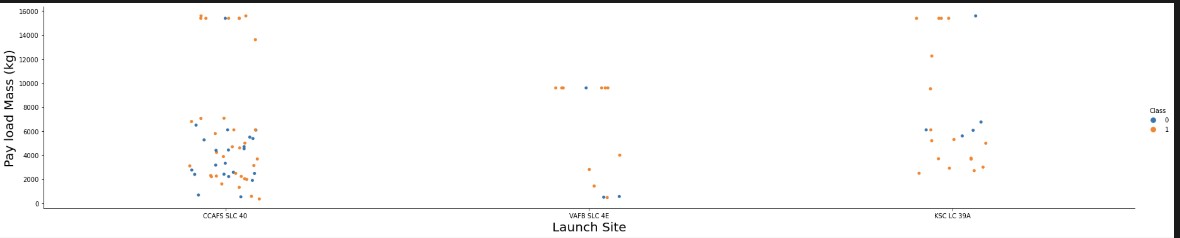
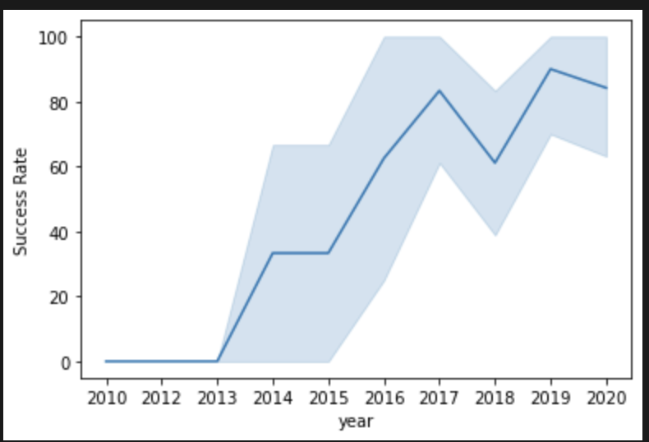
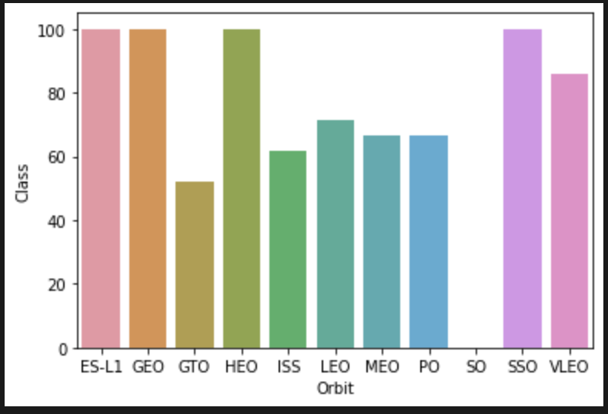
SUCCESS RATE BY YEAR & ORBIT BY CLASS

Slide 12
EDA WITH SQL RESULTS

Slide 13
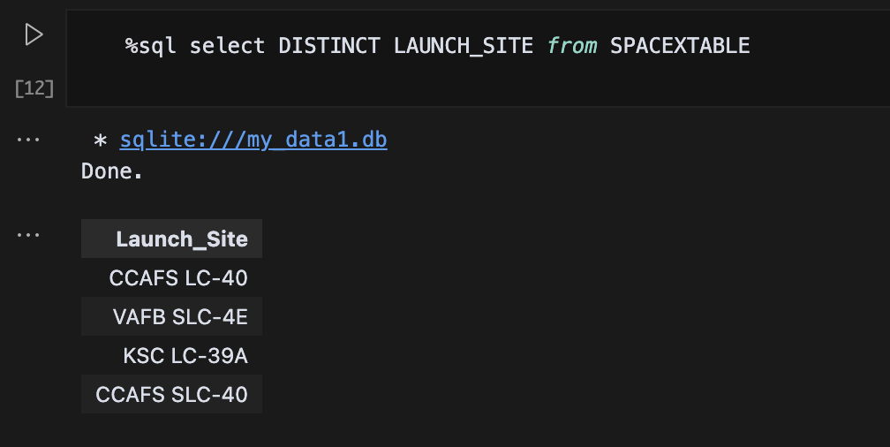
LAUNCH SITE NAMES
The launch site names as shown in the Image are:
CCAFS SLC-40
CCAFS LC-40
KSC LC-39A
VAFB SLC-4E

Slide 14
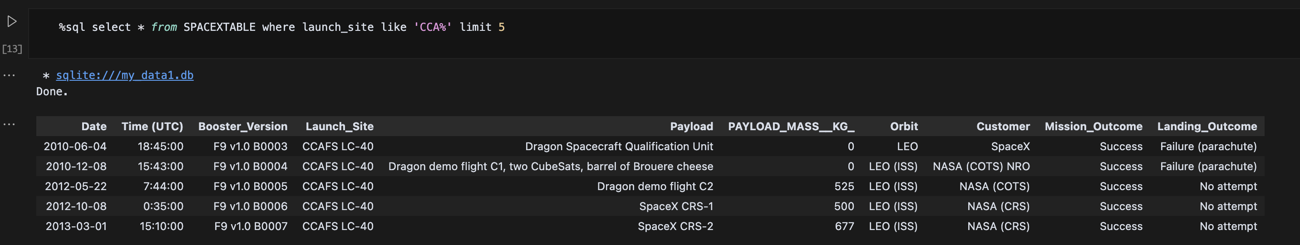
LAUNCH SITE NAMES that begin with ‘cca’

Slide 15
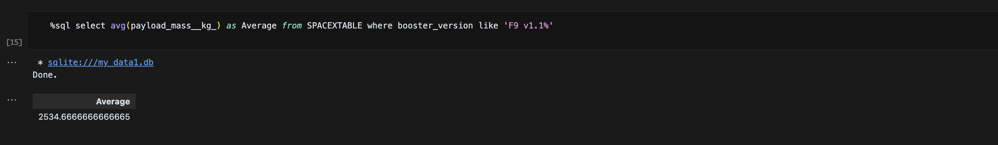
Average Payload Mass by F9 v1.1

Slide 16
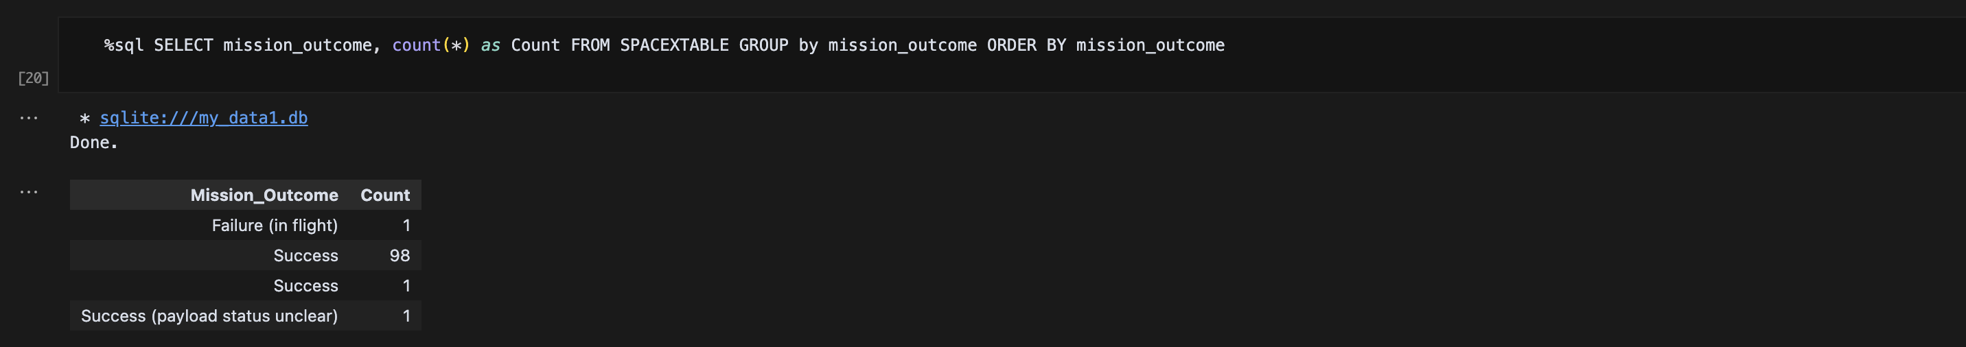
MISSION OUTCOMES

Slide 17
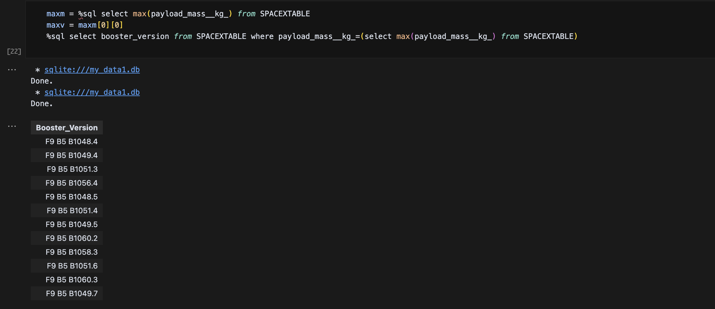
BOOSTERS WITH MAXIMUM PAYLOAD

Slide 18
interactive map with Folium results

Slide 19
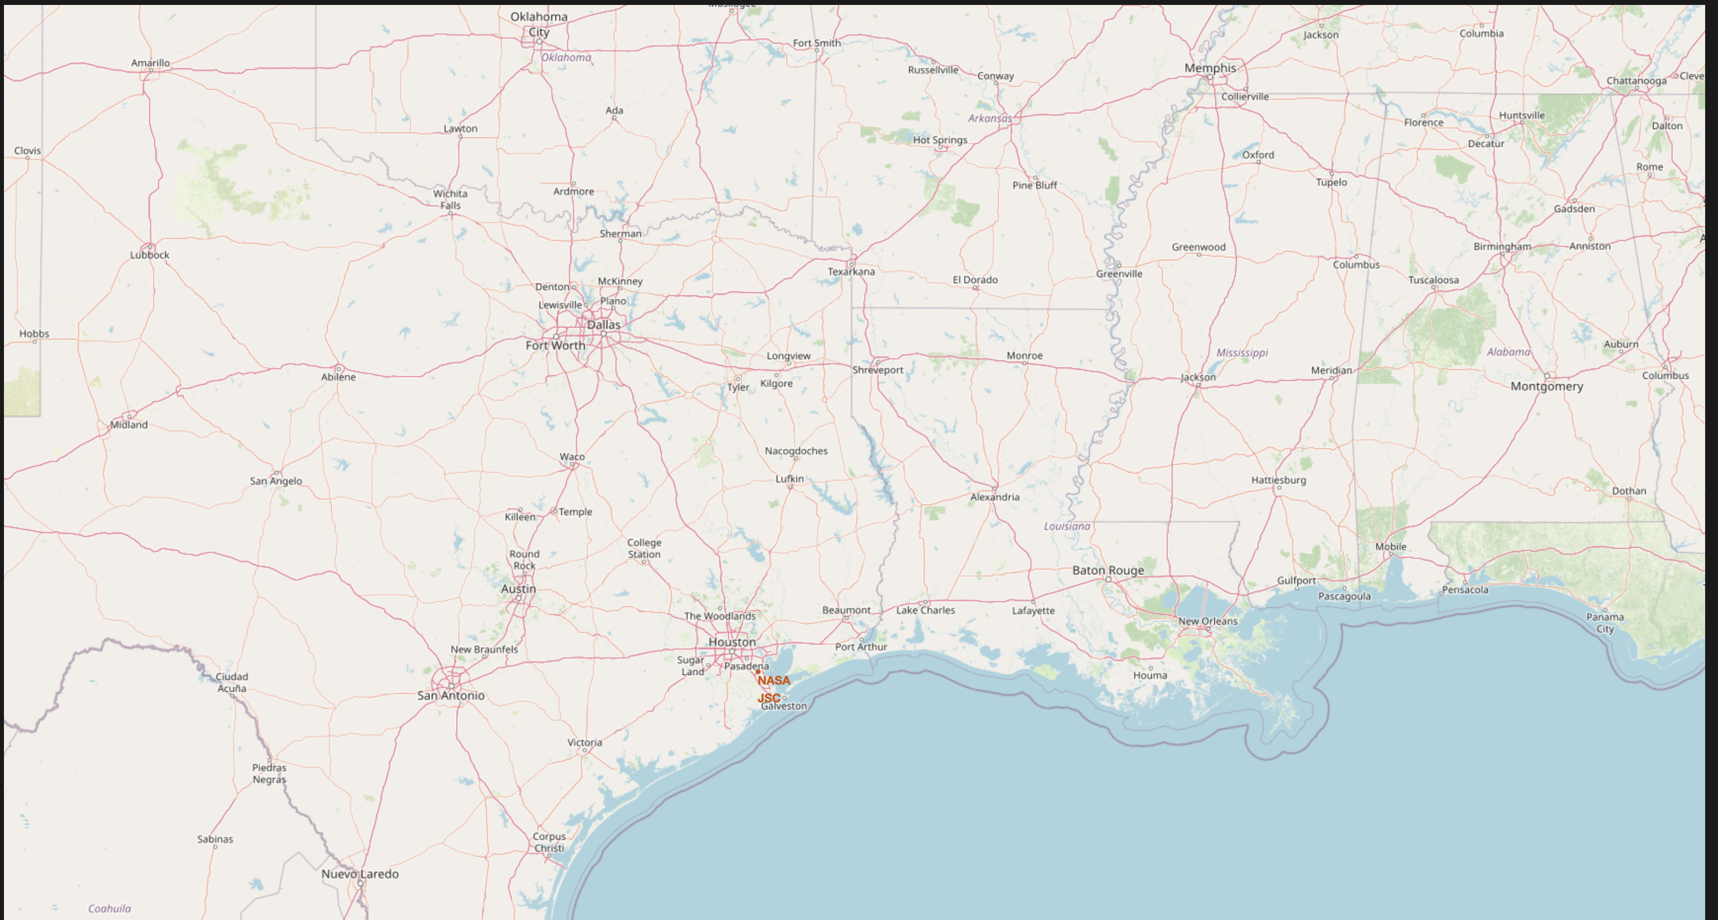
LAUNCH SITES

Slide 20
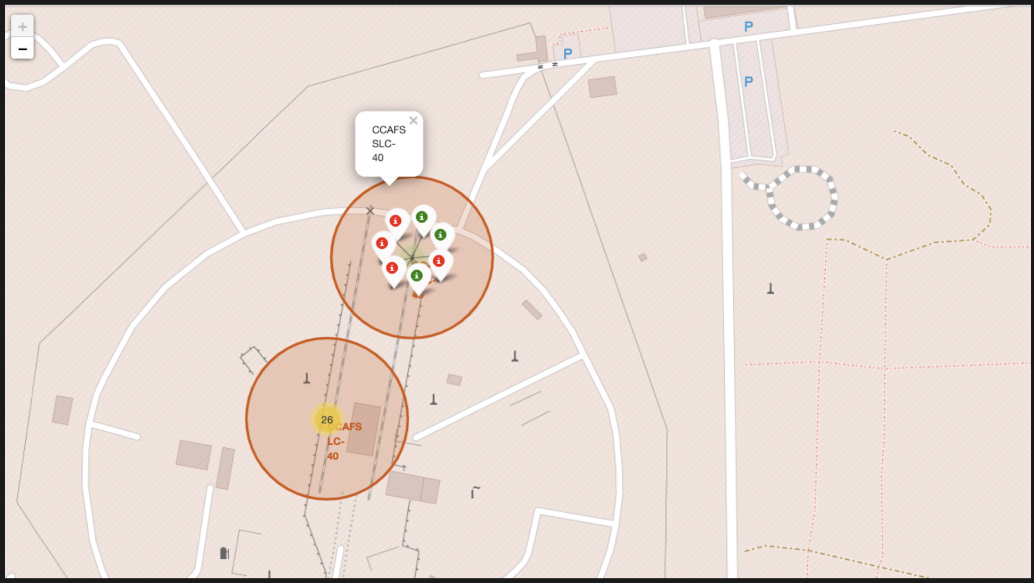
LAUNCH SITES

Slide 21
DASHBOARD WITH PLOTLY

Slide 22

SUCCESSFUL LAUNCHES ACROSS LAUNCH SITES

Slide 23
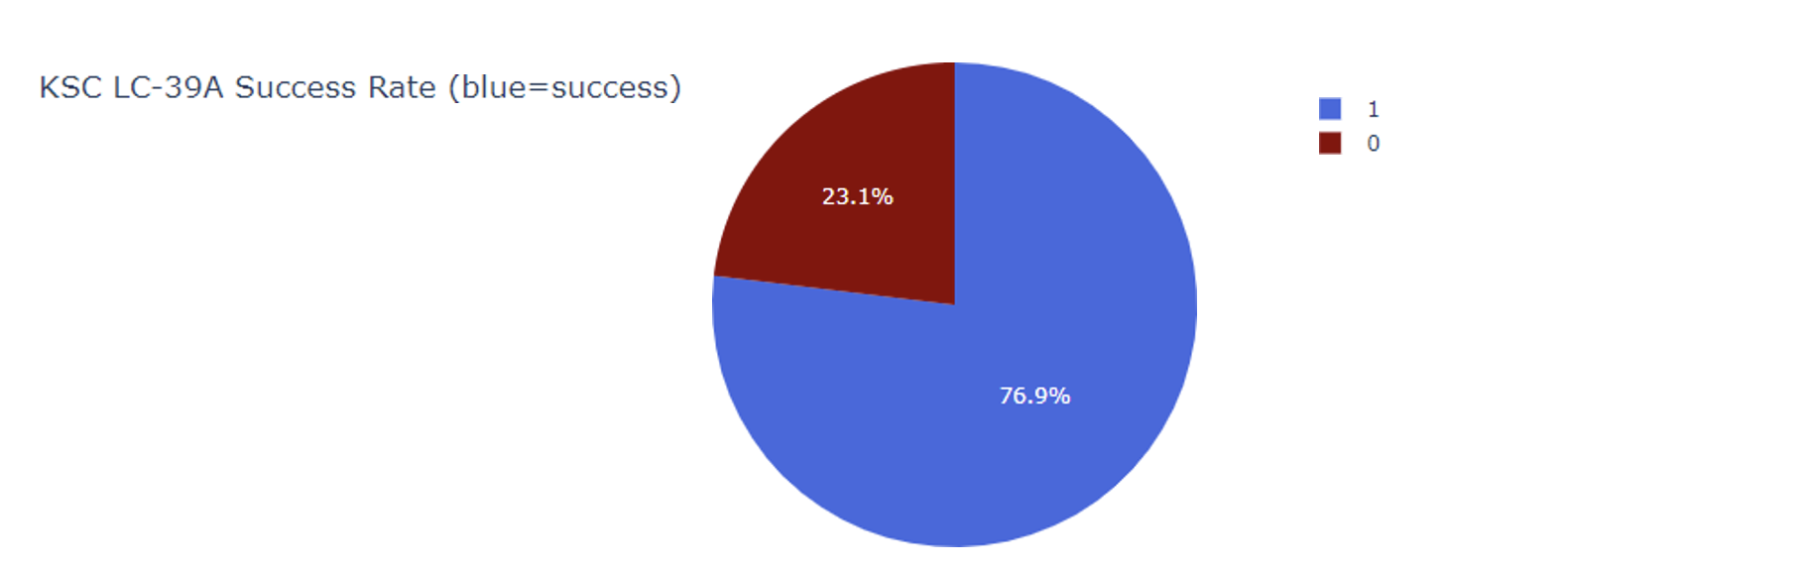
HIGHEST SUCCESS RATE LAUNCH SITE

Slide 24
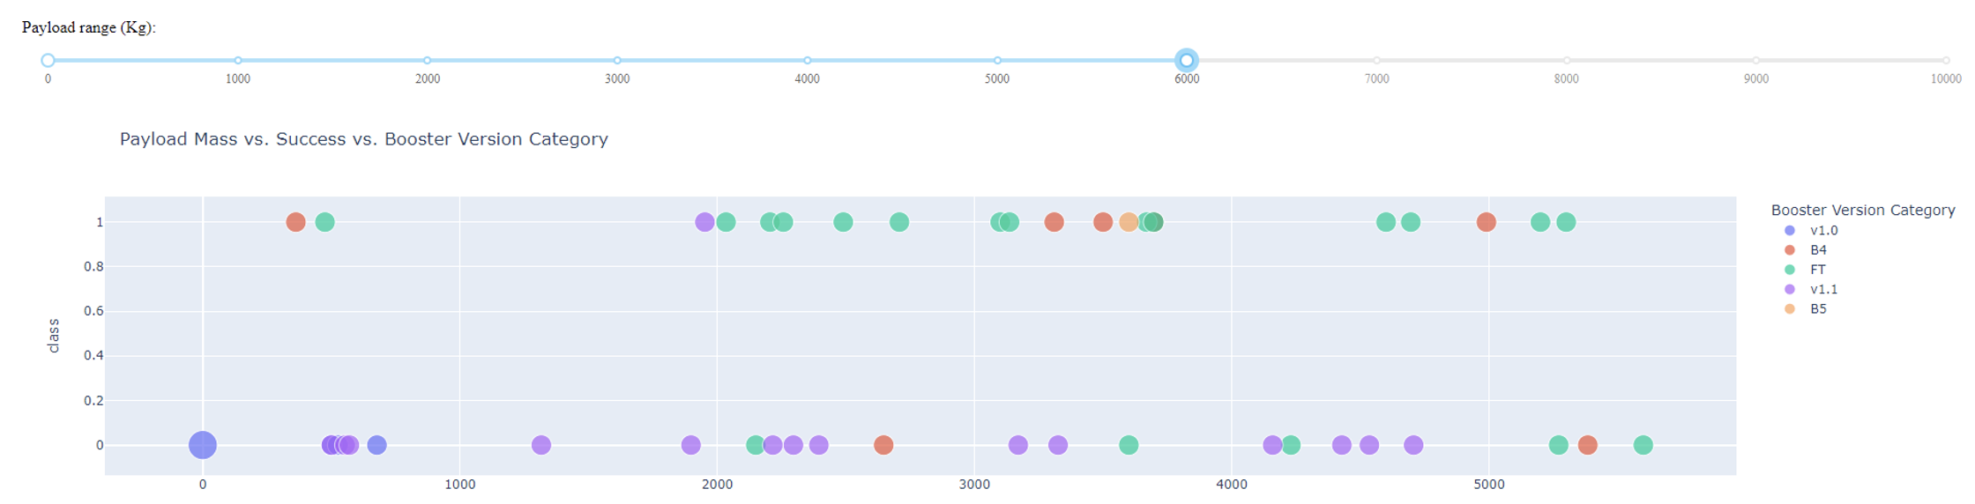
Payload Mass vs. Success vs. Booster Version Category

Slide 25
PREDICTIVE ANALYSIS

Slide 26
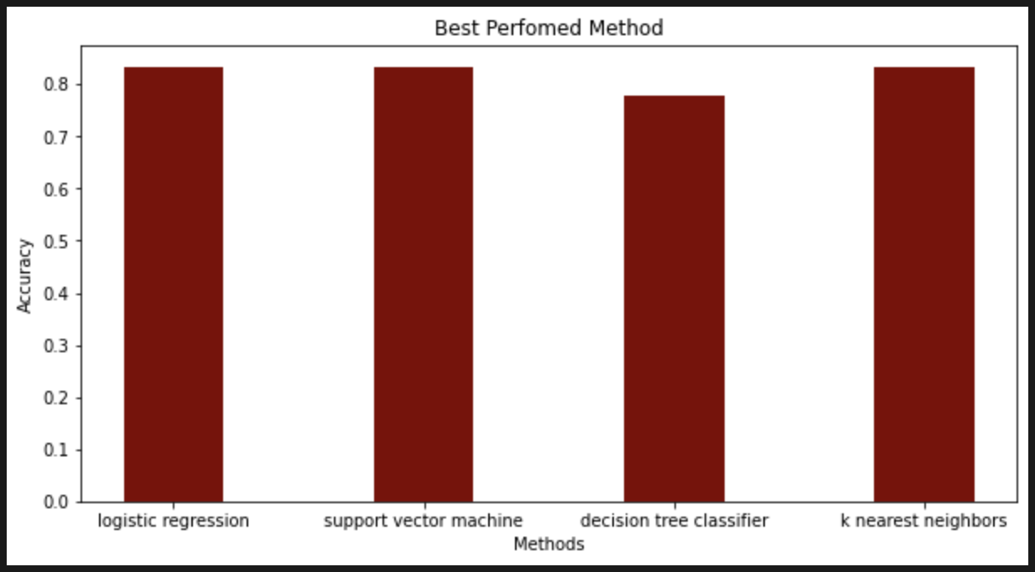
ACCURACY BY MODELS

Slide 27
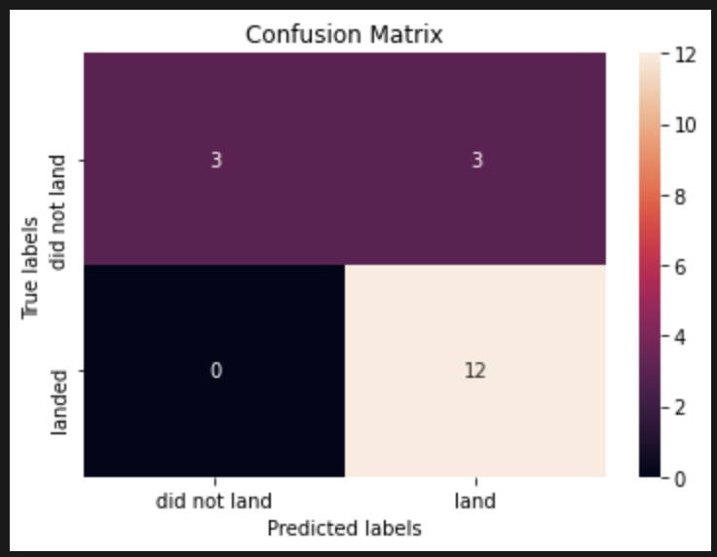
CONFUSION MATRIX

Slide 28
CONCLUSION
Objective: Build a machine learning model for SpaceX to help them compete with SpaceX.
Goal: Predict Stage 1 landing success to potentially save ~ USD 100 million per launch.
Data Sources:
SpaceX public API
Web scraping from SpaceX’s Wikipedia page
Visualization: Developed an interactive dashboard
Model Performance: Achieved 83% accuracy
Use Case:
Enables SpaceX to assess landing success before launch
Supports data-driven go/no-go decisions
Next Steps: Collect more data to refine the model and boost accuracy further

